Slide 1
Prepare by:
Bank Customer Churner Prediction Using PyCaret
Yan Jia Huey | Oct 22, 2021

Slide 2

Customer Churn Definition
Customer churn refer to the percentage of customers who decided to stop doing the business or using service with your company.
To retain an existing customer is much easier than acquire new customers as the existing customer is ease to be convince with least time and cost.
The prediction for customer churn is importance to prevent rate of churn increase.

Slide 3
Bank Customer Churner Analysis Process
Step 1:
Define the business objective
Step 2:
Data gathering from different data source
Step 3:
Data cleaning and feature engineering
Step 6:
Model deployment
Step 5:
Train and test the model
Step 4:
Define a model with right ML algorithm

Slide 4

Dataset Information
Credit card holders In Bank
10127 Observations
23 Features

Slide 5
Categories of Features In Dataset
Credit Information
Customer Demographics
Customer Product Relationship & Transactions
Bank credit card
Age
Gender
Income category
Education level
Marital status
Card category
Credit limit
Total revolving balance
Total transaction amount
Total transaction count
Average utilization ratio of credit card

Slide 6
Target
To predict the bank customers in a bank whether to ……
Churn
Not Churn
OR

Slide 7
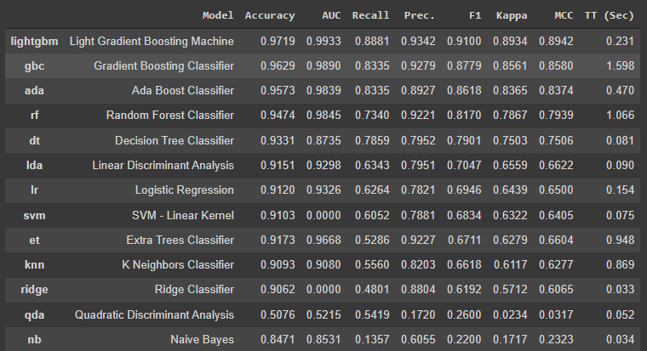
Top 3 models sort by F1
compare_models(sort='F1’)
F1 score for top 3 models:
Lightgbm = 91%
Gbc = 87.79%
Ada = 86.18%

Slide 8

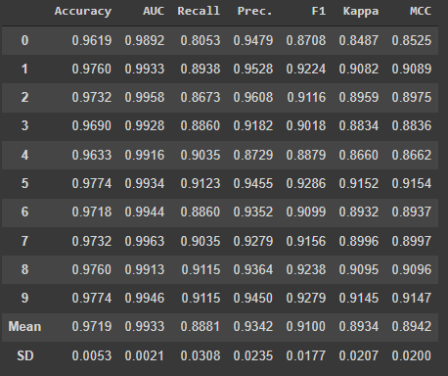
Create models for best model: Lightgbm
best_model = create_model('lightgbm’)
Lightgbm F1 score:
0.9100 = 91%

Slide 9
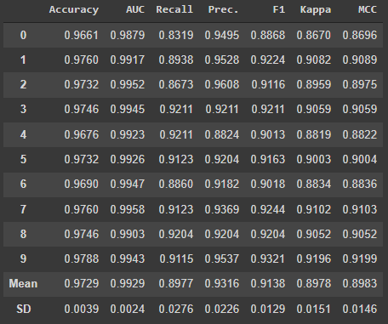
Tune model: Lightgbm
Tune the best model to get better F1 score….
lr_tuned = tune_model(best_model,
n_iter=50,
optimize='F1',
custom_grid=params
)
Lightgbm F1 score after tune:
0.9138 = 91.38%

Slide 10
Lightgbm F1 score between tune and before tune
Model before tune
Model after tune
Lightgbm F1 score:
0.9100 = 91%
Lightgbm F1 score after tune:
0.9138 = 91.38%

Slide 11
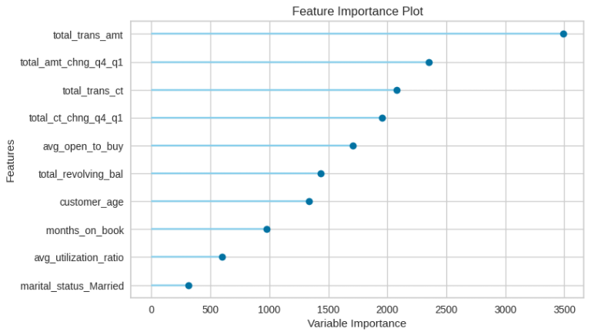
Feature Importance: Lightgbm
The 10 most important feature that sorted by highest scores for prediction…
plot_model(lr_tuned, plot='feature’)

Slide 12
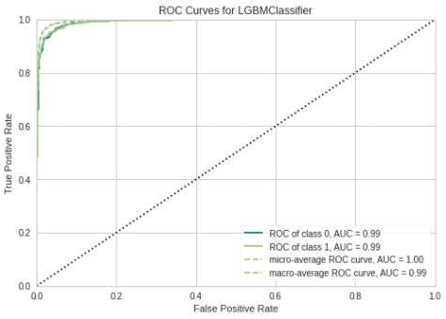
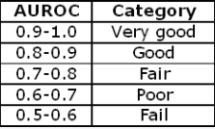
ROC-AUC Curves: Lightgbm
plot_model(lr_tuned)
AUROC Category
0.99 AUROC Score

Slide 13
Confusion Matrix: Recall Or Precision?
Precision is refer to the correctly positive cases out of all predicted as positive, which is how precise of actual positive when it predicts as positive. For instance, out of 10 customer predicted as churn by the model, how many customer are correct churn.
Recall is refer to the number of true positives cases out of all positives in dataset, which is how often predicted correctly as positive. For instance, out of 10 churn customer in the data, how many customer classified correctly as churn customer.
As observation at above, we shall using recall for confusion matrix measurement. This reason is we wish to find out how many customers are correctly predicted as churn from 10127 rows in this dataset.
We deal with Recall !!

Slide 14
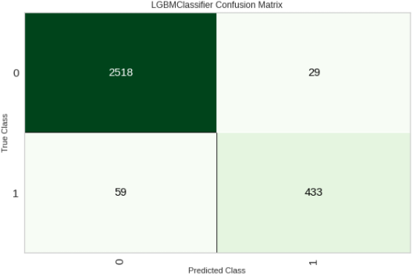
Confusion Matrix: Lightgbm (Recall)
evaluate_model(lr_tuned)
True Positive : 433
True Negative : 2518
False Negative : 59
False Positive : 29
Recall Formula: TP/(TP + FN)
Recall = 433/(433 + 59)
=0.8800813
88% Recall Score

Slide 15
Deploy Model: Save & Load Model
Save the model:
save_model(best_model, model_name='bank_churner_train_01')
load the model:
best_model = load_model('bank_churner_train_01’))

Slide 16
Deploy Model: Create User Input
user_request = [{
'customer_age': 30,
'gender': 'M',
'dependent_count': 4,
'education_level': 'High_School',
'marital_status': 'Single',
'income_category': '$60K - $80K',
'card_category': 'Blue',
'months_on_book': 30,
'total_relationship_count': 4,
'months_inactive_12_mon': 1,
'contacts_count_12_mon': 4,
'credit_limit': 30000,
'total_revolving_bal': 800,
'avg_open_to_buy': 29000,
'total_amt_chng_q4_q1': 1.345,
'total_trans_amt': 350, #1000
'total_trans_ct': 40,
'total_ct_chng_q4_q1': 1.525,
'avg_utilization_ratio': 0.051
}] user_request = pd.DataFrame(user_request)
Print out the data after create the data frame with user input

Slide 17
Deploy Model: Predict Model
predict_model(best_model, user_request)
89.98%
Prediction Score

Slide 18
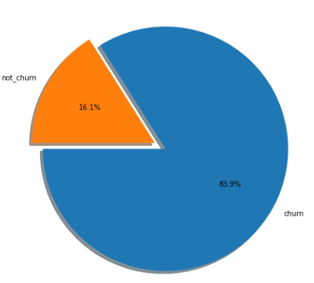
Future Improvement
Improvement:
There are total 16.1% of churn customer and 83.9% of not churn customer in this dataset, which is imbalance. The probability threshold adjustment shall apply to solve the imbalance dataset.

Slide 19

Future Research
Research:
Gather the new data by Implement qualitative research such as online survey to identify customer requirements to find out reasons of churn.
~THANK YOU ~

